Slide 1
Regular Expressions
CSE331 - Automate and Computability
BRAC University

Slide 2
Introduction to RegEx

Slide 3
Introduction
Languages: We know that there are four different types of automata. Each automaton has its own language that it recognizes/accepts:
Automaton | Corresponding language
Finite State Automaton (FSA) | Regular language (RE)
Pushdown Automaton (PDA) | Context-free language (CFL)
Linear Bound Automaton (LBA) | Context sensitive language (CSL)
Turing Machine (TM) | Recursively Enumerable Language (REL)

Slide 4
Defining a Regular Language
Regular language: It is a simple language with a bunch of strings in it. We shall learn it more formally later.
● A simple regular language can be described intuitively in several ways.
You can list all the strings of the language in a tabular set format e.g. {𝑎𝑐, 𝑐𝑎, 𝑎𝑏𝑐, 𝑐𝑏𝑎, 𝑎𝑐, 𝑐𝑎, 𝑎𝑏𝑐, 𝑐𝑏𝑎, 𝑎𝑏𝑑𝑏𝑐, 𝑐𝑏𝑏𝑑𝑑𝑎, 𝑐𝑑𝑑𝑎, 𝑎𝑑𝑐, … }. If the language is too large or infinite, this description is not good.
Also, you can start describing the language in words like we do in set builder method. We can express the above language as- {𝐶𝑜𝑛𝑡𝑎𝑖𝑛𝑖𝑛𝑔 𝑠𝑡𝑟𝑖𝑛𝑔𝑠 𝑡ℎ𝑎𝑡 𝑠𝑡𝑎𝑟𝑡 𝑤𝑖𝑡ℎ 𝑎𝑛 𝒂 𝑜𝑟 𝑎 𝒄. 𝐼𝑓 𝑖𝑡 𝑠𝑡𝑎𝑟𝑡𝑠 𝑤𝑖𝑡ℎ 𝑎𝑛 𝒂,𝑡ℎ𝑒𝑛 𝑖𝑡 𝑒𝑛𝑑𝑠 𝑤𝑖𝑡ℎ 𝑎 𝒄, 𝑎𝑛𝑑 𝑖𝑓 𝑖𝑡 𝑠𝑡𝑎𝑟𝑡𝑠 𝑤𝑖𝑡ℎ 𝑎 𝒄 𝑡ℎ𝑒𝑛 𝑖𝑡 𝑒𝑛𝑑𝑠 𝑤𝑖𝑡ℎ 𝑎𝑛 𝒂 … }
You can draw an FSA that accepts the above language. Though this method will work perfectly, the drawing something is a bit tedious too. Is there a better way?
Lastly, we have Regular Expression which is easy to derive and often concise to write like a mathematical expression.
● Whether you can find it or not, there is a pattern in every regular language. This pattern is known as an Expression.
● If a language is regular, then its expression is called a regular expression (RE) or RegEx.
● Every regular language (RL) has one or more regular expressions, i.e. RE of a language is not unique.

Slide 5
Basic Regular Operations

Slide 6
Three Basic Regular Operations (for RegEx)
In a regular expression, three types of operators can be present:
Operator name | Symbol
OR Operator | | or +
Concatenation Operator | . or <no symbol>
Kleene closure operator Positive closure operator | * +

Slide 7
The OR Operator (| or +)
Position : It sits between two things e.g. 𝑅1|𝑅2 where each of 𝑅1 and 𝑅2 can be any string, a symbol or even another RegEx. You can also write them using + sign e.g. 𝑅1 + 𝑅2.
Meaning : 𝑅1 or 𝑅2 means that you may take the one from the left or the one from the right. If you take the one from the left, you get 𝑅1, and if you take the one from the right, you get 𝑅2.
Examples :
𝑎 | 𝑏 = {𝑎, 𝑏}
𝑎𝑎 | 𝑏 = {𝑎𝑎, 𝑏}
ℎ𝑒𝑙𝑙𝑜 | ℎ𝑖 = {ℎ𝑒𝑙𝑙𝑜, ℎ𝑖}
(0 | 01) | 001 = 0 | 01 | 001 = {0, 01, 001}

Slide 8
The CONCATENATION Operator (. or <no symbol>)
Definition : It is a binary operator but it is NOT like the and operator that you saw in Boolean algebra.
Position : It sits between two things e.g. 𝑅1 ⋅ 𝑅2 where each of 𝑅1 and 𝑅2 can be any string, a symbol or even another RegEx. You can also write 𝑅1 and 𝑅2 side by side without any sign e.g. 𝑅1𝑅2.
Meaning : 𝑅1 or 𝑅2 means that you take the 𝑅1 first and then append 𝑅2 to the right.
Examples :
𝑎 ⋅ 𝑏 = {𝑎𝑏}
𝑎𝑎 ⋅ 𝑏 = {𝑎𝑎𝑏}
ℎ𝑒𝑙𝑙𝑜 ⋅ ℎ𝑖 = {ℎ𝑒𝑙𝑙𝑜ℎ𝑖}
(0 ⋅ 01) ⋅ 001 = 0 ⋅ 01 ⋅ 001 = {001001}

Slide 9
Combination of Concatenation and OR
Position : It sits between two things e.g. 𝑅1|𝑅2 where each of 𝑅1 and 𝑅2 can be any string, a symbol or even another RegEx. You can also write them using + sign e.g. 𝑅1 + 𝑅2.
Meaning : 𝑅1 or 𝑅2 means that you may take the one from the left or the one from the right. If you take the one from the left, you get 𝑅1, and if you take the one from the right, you get 𝑅2.
Examples :
𝑎 | 𝑏 = {𝑎, 𝑏}
𝑎𝑎 | 𝑏 = {𝑎𝑎, 𝑏}
ℎ𝑒𝑙𝑙𝑜 | ℎ𝑖 = {ℎ𝑒𝑙𝑙𝑜, ℎ𝑖}
(0 | 01) | 001 = 0 | 01 | 001 = {0, 01, 001}

Slide 10
RegEx Equivalence with Finite Automata

Slide 11
Formal Definition of Regular Expressions
Formal Definition: Say that R is a regular expression if R is
a for some a in the alphabet Σ,
ε,
∅,
(R1 ∪ R2), where R1 and R2 are regular expressions,
(R1 ◦ R2), where R1 and R2 are regular expressions, or
(R1 ∗), where R1 is a regular expression.
● In items 1 and 2, the regular expressions a and ε represent the languages {a} and {ε}, respectively.
● In item 3, the regular expression ∅ represents the empty language.
● In items 4, 5, and 6, the expressions represent the languages obtained by taking the union or concatenation of the languages R1 and R2, or the star of the language R1, respectively.
● For convenience, we let R+ be shorthand for RR∗
● In addition, we let Rk be shorthand for the concatenation of k R’s with each other.

Slide 12
RegEx (Examples)
Examples: In the following instances, we assume that the alphabet Σ is {0,1}.
0∗ 1 0∗ = {w| w contains a single 1}.
Σ∗ 1 Σ∗ = {w| w has at least one 1}.
Σ∗ 001 Σ∗ = {w| w contains the string 001 as a substring}.
1∗ (01+)∗
(ΣΣ)∗ = {w| w is a string of even length}.
(ΣΣΣ)∗ = {w| the length of w is a multiple of 3}.
01 ∪ 10 = {01, 10}.
(0 Σ∗ 0) ∪ (1 Σ∗ 1) ∪ 0 ∪ 1 = {w| w starts and ends with the same symbol}.
(0 ∪ ε)1∗ = 01∗ ∪ 1∗. Note: The expression 0 ∪ ε describes the language {0, ε}, so the concatenation operation adds either 0 or ε before every string in 1∗.
(0 ∪ ε)(1 ∪ ε) = {ε, 0, 1, 01}.
1∗∅ = ∅. Note: Concatenating the empty set to any set yields the empty set.
∅∗ = {ε}. Note: The star operation puts together any number of strings from the language to get a string in the result. If the language is empty, the star operation can put together 0 strings, giving only the empty string.

Slide 13
RegEx (Identities)
Identities: If we let R be any regular expression, we have the following identities. They are good tests of whether you understand the definition.
● R ∪ ∅ = R.
Adding the empty language to any other language will not change it.
● R ◦ ε = R.
Joining the empty string to any string will not change it.
● R ∪ ε may not equal R.
For example, if R = 0, then L(R) = {0} but L(R ∪ ε) = {0, ε}.
● R ◦ ∅ may not equal R.
For example, if R = 0, then L(R) = {0} but L(R ◦ ∅) = ∅.

Slide 14
RegEx and Finite Automata Equivalence
Theorem: A language is regular if and only if some regular expression describes it. This theorem has two directions. We state and prove each direction as a separate lemma.
● Lemma-1
If a language is described by a regular expression, then it is regular. (RegEx to NFA)
● Lemma-2
If a language is regular, then it is described by a regular expression. (DFA to RegEx)

Slide 15
RegEx to NFA (Proof Idea and Proof)
Proof Idea:
Say that we have a regular expression R describing some language A. We show how to convert R into an NFA recognizing A. We know, if an NFA recognizes A then A is regular.
Proof:
Let’s convert R into an NFA N. We consider the six cases in the formal definition of regular expressions (Slide-11)

Slide 16
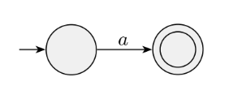
RegEx to NFA (Case-1)
Case-1:
R = a for some a ∈ Σ. Then L(R) = {a}, and the following NFA recognizes L(R).
Note:
This machine fits the definition of an NFA but not that ofa DFA because it has some states with no exiting arrow for each possible input symbol.
Of course, we could have presented an equivalent DFA here; but an NFA is all we need for now, and it is easier to describe.
Formally, N = ({q1, q2}, Σ, δ, q1, {q2}), where we describe δ by saying that δ(q1, a) = {q2} and that δ(r, b) = ∅ for r != q1 or b != a.

Slide 17

RegEx to NFA (Case-2)
Case-2:
R = ε. Then L(R) = {ε}, and the following NFA recognizes L(R).
Note:
Formally, N = ({q1}, Σ, δ, q1, {q1}), where δ(r, b) = ∅ for any r and b.

Slide 18
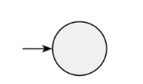
RegEx to NFA (Case-3)
Case-2:
R = ∅. Then L(R) = ∅, and the following NFA recognizes L(R).
Note:
Formally, N = ({q}, Σ, δ, q, ∅), where δ(r, b) = ∅ for any r and b.

Slide 19
RegEx to NFA (Case-4, 5, 6)
Case-4: Union
R = R1 ∪ R2.
Case-5: Concatenation
R = R1 ◦ R2.
Case-5: Star
R = R1*.
Note:
For the last three cases, we use the constructions given in the proofs that the class of regular languages is closed under the regular operations.

Slide 20
RegEx to NFA (Approach)
Approach
We build up from the smallest subexpressions to larger subexpressions until we have an NFA for the original expression.
Note that this procedure generally doesn’t give the NFA with the fewest states.

Slide 21
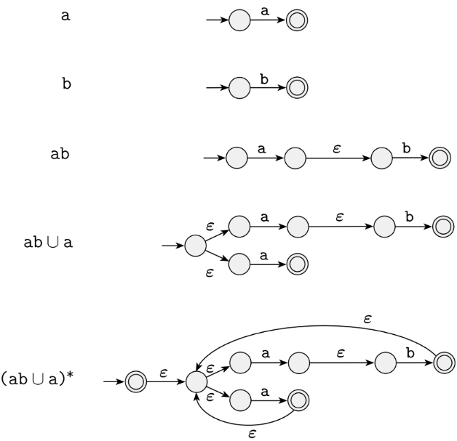
RegEx to NFA (Example-1)
Example-1: Convert the regular expression (ab ∪ a)* to an NFA

Slide 22
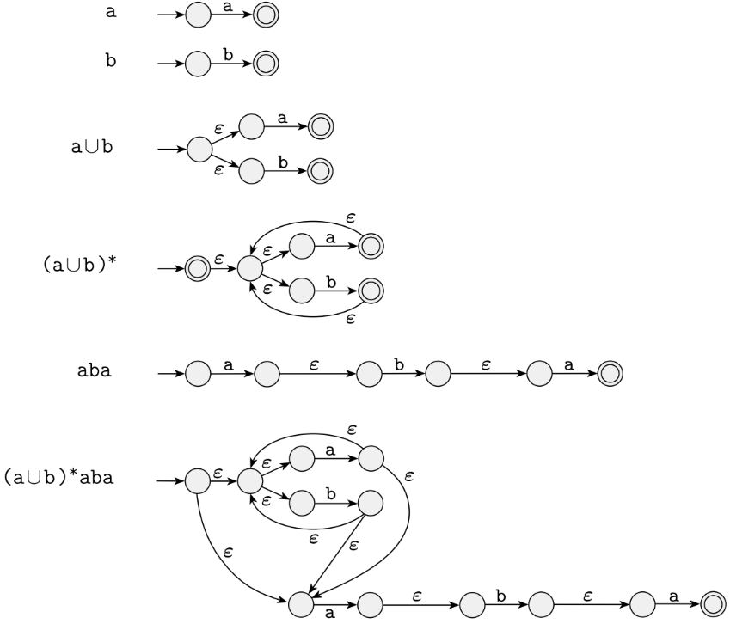
RegEx to NFA (Example-2)
Example-1: Convert the regular expression (a ∪ b)*aba to an NFA

